Slide 1

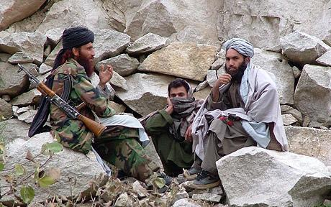



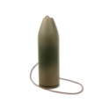
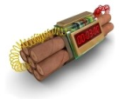

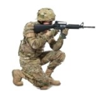
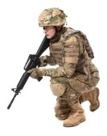
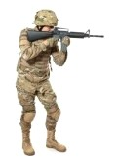

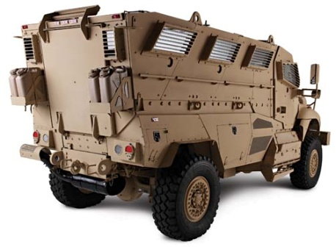
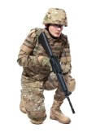
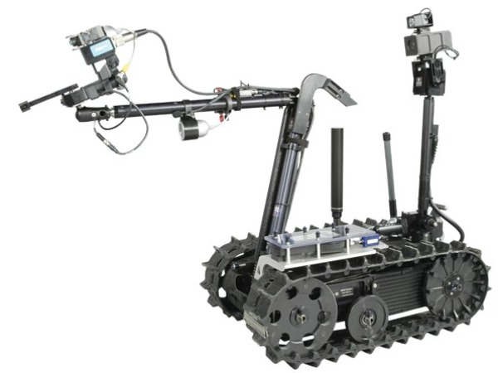
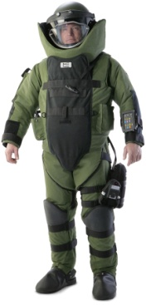

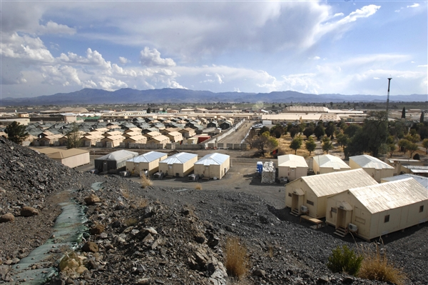
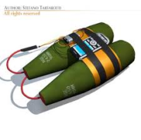


INSURGENT ATTACK
Operational Vignette - 1
Booby-trap IED
Cell phone triggered IED
DETECT
DETECT
INTERACT
COMMUNICATE
DEPLOY
DETECT
DETECT
DETECT
Explosive Ammunition IED
SMETAL-V
Command and Control
Timed IED
IED Landmine

Slide 2

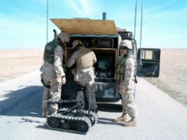
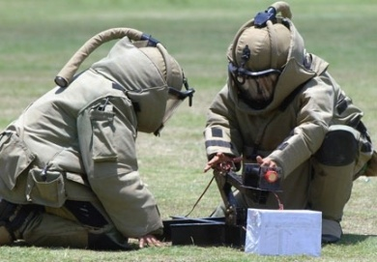
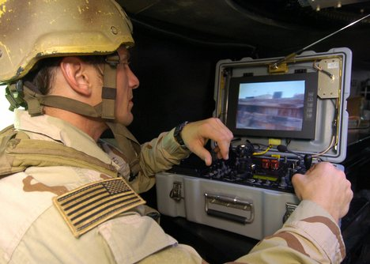
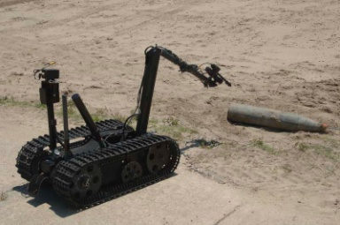
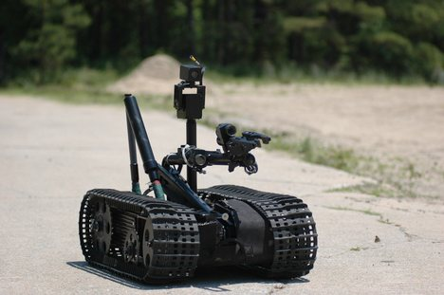
SMETAL-V
Initialize SMETAL-V
Alert Vehicle Operator
Search for Threats (IEDs)
Store SMETAL-V
Power On
Run Diagnostics
Accept Search Space Parameters from User
Autonomously Navigate Terrain
Interpret Search Results
Record and Store Search Results
Transmit Communication
Power Off
Arrive at Scene
Defeat IED
Program SMETAL-V
IED Detection
Search for IED

Slide 3


User
Power On
Remove IED to Safe Location
Physical Interfacing
Interpret Search Results
Initiation Signal
Autonomously Navigate Terrain
Sensory Signal
Ready State
Visual Alert
Parameter Insertion
Initialize SMETAL-V
Vehicle Operator
Data Analysis
Motor Control Signal
Data
Initiation Signal
Record and Store Search Results
Accept Search Space Parameters from User
Visual Alert
Search for Threats (IEDs)
Initiation Signal
Transmit Communication
Sensory Signal
Data Storage
Communication
Communication
Programming/Control Unit
Alert Vehicle Operator
Communication
Physical Interfacing
Power Off
Scheduled Event Signal
Physical Interfacing
Run Diagnostics
Store SMETAL-V

